Slide 1

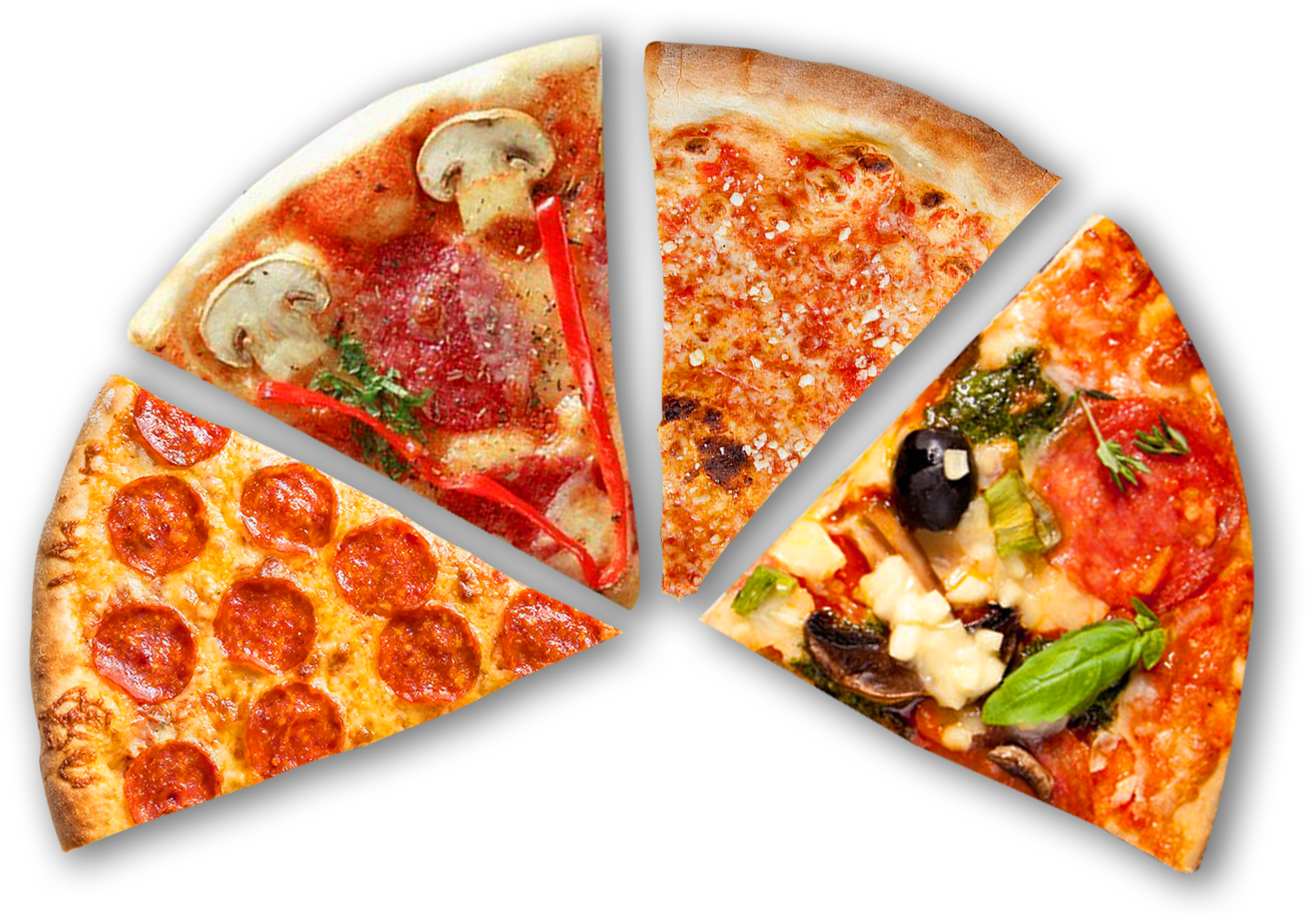

Data-Driven Analysis of PizzaToons Sales for Business Expansion to Kothrud
Using One-Year Sales Data to Support an Investment Decision
Presented By: Sanket Jadhav
Batch : 420

Slide 2


Introduction
PizzaToon — Premium Pizza Store in Hinjewadi
Known for quality ingredients & great atmosphere
Opened on 1 Jan 2015
Successfully run by Mr. Sharma (Hotel Management – USA)
Now planning to open a new branch in Kothrud

Slide 3



Problem Statement
Why Do We Need Data Before Expanding?
Problem 1 — Funding
₹50 Lakh investment — investor needs proof of profit.
Problem 2 — Competition
Kothrud already has strong brands (Domino’s & Pizza Hut).
Problem 3 — Limited Resources
We must design the right menu & staffing within budget.
So our job: Use 1-year Hinjewadi data to prove that Kothrud can be profitable.

Slide 4
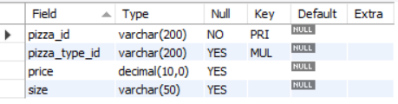
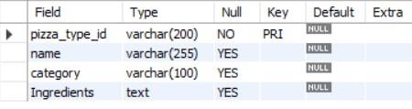
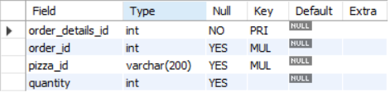
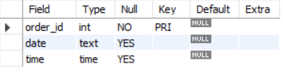
Let’s See Data
Our Dataset & Table Structure
pizza
pizza_types
order_details
orders
This database structure allows accurate SQL analysis

Slide 5
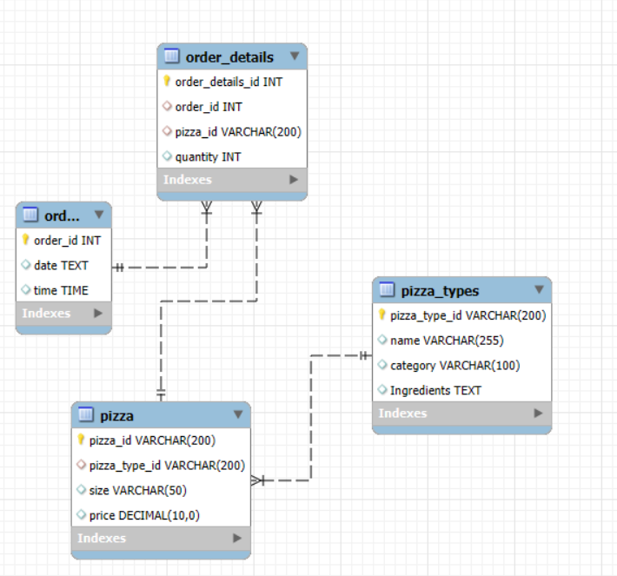
ER Diagram
🧾 orders → When the customer placed the order 📦 order_details → Which pizzas & how many in that order 🍕 pizza → Pizza size & price 🏷 pizza_types → Pizza name, category & ingredients

Slide 6

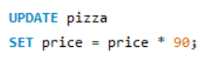
1.Converting Prices from USD to INR for Better Understanding
Original dataset stored pizza prices in USD
Investor is Indian — Rupee values are easier to understand
All revenue, averages & charts shown in ₹ (INR)
Example: $1 → ₹90

Slide 7

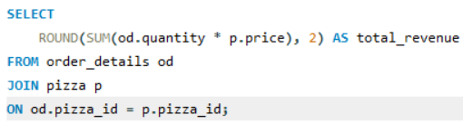
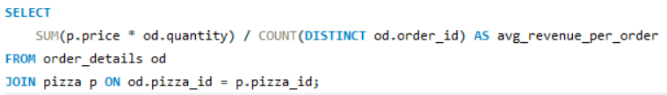
2.Does This Business Even Make Money?
🛍 Total Orders ✔ 21,350 orders
💰 Total Revenue (₹) ✔ ₹ 7.44 Crores
📦 Average Bill Per Order ✔ ₹ ~3,488
Premium Pricing — customers are willing to pay for quality.

Slide 8
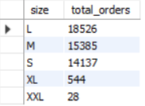
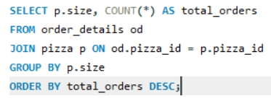

3.But Hinjewadi is IT Crowd… Will This Work in Kothrud?
Out of 48,620 pizzas sold — 18,526 were Large size.
Most customers prefer Large / Family pizzas
Hinjewadi = office crowd, still buying big meals
In Kothrud (families & students) this demand can be even stronger
Domino’s in Kothrud pushes small cheap pizzas PizzaToon already knows how to sell premium large pizzas

Slide 9
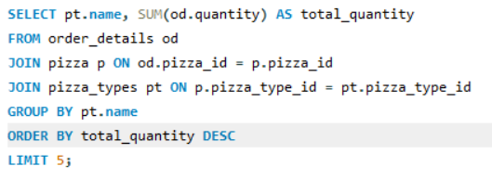
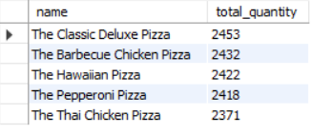
4.Designing the Right Menu for Kothrud
These 5 pizzas contribute the majority of volume & revenue.

Slide 10
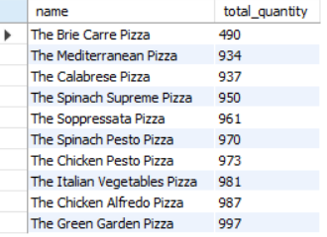
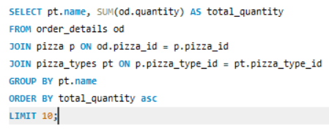
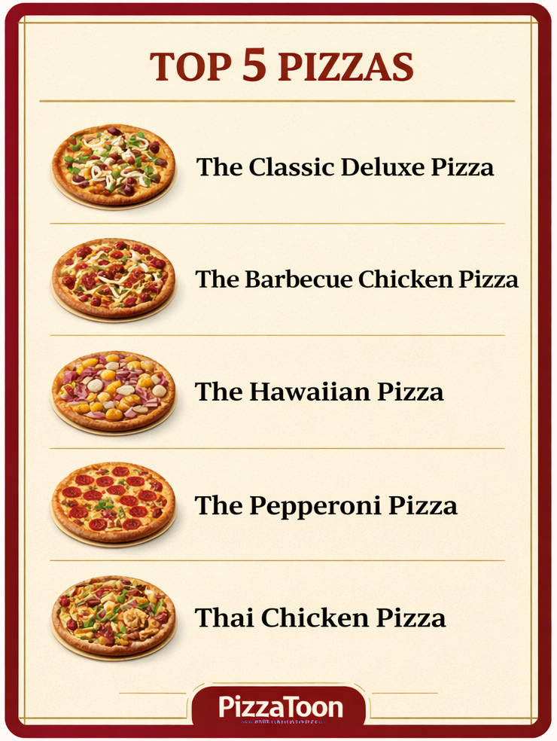
Bottom 10 pizzas = very low sales — rarely ordered
Less Inventory = Less Risk + Faster Service + Better Quality

Slide 11
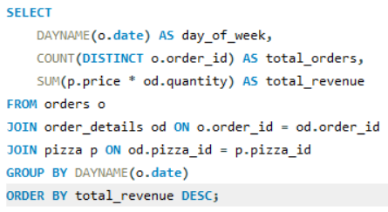
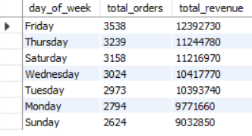

5.When Do We Actually Need More Staff?
Friday = Peak Day

Slide 12
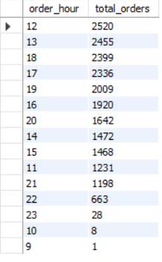
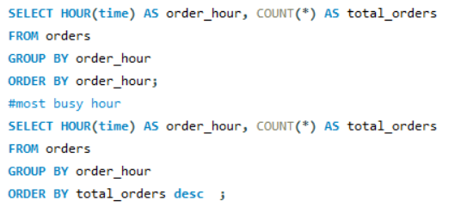


Peak Hours = Evenings
Hire Part-Time Staff Only for Peak Day/Hours

Slide 13

Conclusion:
₹7 Crore+ annual revenue & 21,350 orders prove strong demand
Large pizzas dominate — perfect fit for family-heavy Kothrud
Top 5 pizzas drive most sales — simplified, low-risk menu
Peak-based staffing reduces cost & increases efficiency
Premium brand positioning already works — customers pay for quality
Data-Driven Expansion = Confident Investment Decision

Slide 14

THANK YOU

